Slide 1

Lagash Systems
Mariano Sánchez – Software Architect
marianos@lagash.com @marianosz
http://weblogs.asp.net/marianos

Slide 2

Que hay de nuevo en C#6

Slide 3
Agenda
Hablemos de Roslyn
C# 6 New Features
A codear!
C# New Features
Diagnostics and Code Fix

Slide 4
Hablemos de Roslyn

Slide 5
Compilador
CSC - VBC
?
class Program
{
void Main()
{
}
} ▫
program.exe

Slide 6
Roslyn – .NET Compiler Platform
Completa reescritura de los compiladores C# y Visual Basic
Open Source – http://github.com/dotnet/roslyn
Language Services
Code Analysis APIs
Extensibilidad
Scripting

Slide 7
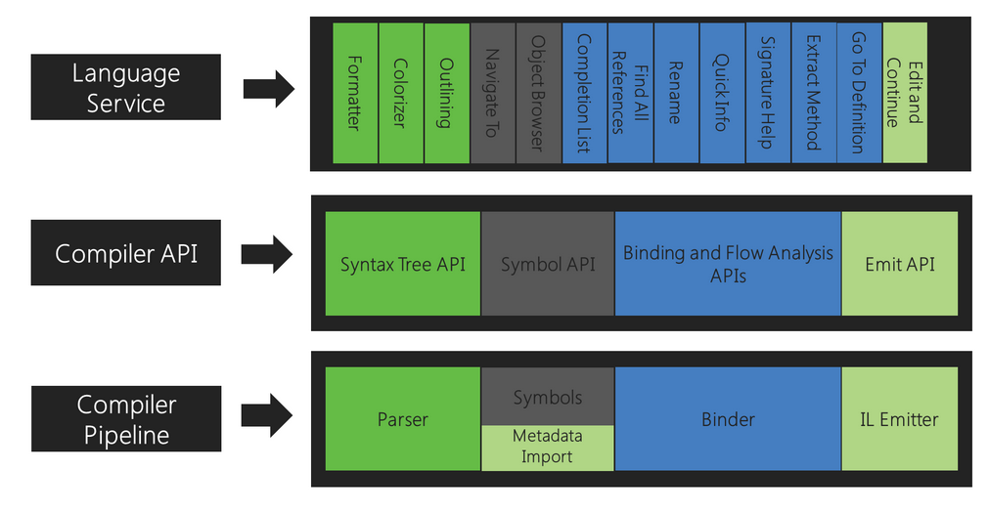
Compiler APIs

Slide 8





Ecosistema .NET
.NET in devices and services
Openness
Cloud Services
Windows Convergence
.NET support for
Azure Mobile Services
Universal projects
Web apps
Native compilation
ASP.NET updates
.NET Native
Azure and Windows Server
Windows Desktop
Windows Store
iOS and Android
Core .NET
Runtime
Compilers
Next gen JIT (“RyuJIT”)
SIMD
.NET Compiler Platform (“Roslyn”)
Languages innovation

Slide 9
C# 6 New Features

Slide 10
C# 6 New Features
using static
get only auto properties
Expression Bodied methods
String interpolation
nameof operator

Slide 11
C# 6 New Features
Null-Conditional operator (?.) - aka Elvis operator
Object initializer for indexers
Exception Filtering
await en catch / finally

Slide 12
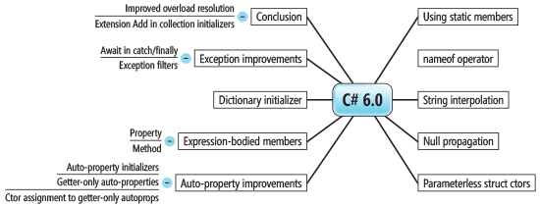
C# 6 New Features
C# 6 Features

Slide 13
A codear! C# New Features Diagnostics and Code Fix

Slide 14
Preguntas?

Slide 15
Recursos
Roslyn
https://github.com/dotnet/roslyn
Roslyn SDK
https://visualstudiogallery.msdn.microsoft.com/2ddb7240-5249-4c8c-969e-5d05823bcb89
C# Essentials
https://visualstudiogallery.msdn.microsoft.com/a4445ad0-f97c-41f9-a148-eae225dcc8a5
C# 6 – Whats new
https://msdn.microsoft.com/en-us/magazine/dn879355.aspx

Slide 16
Muchas Gracias
Mariano Sánchez – Software Architect
marianos@lagash.com @marianosz
http://weblogs.asp.net/marianos

